Slide 1

Wireless Classroom Clicker
Portland State University
Team: T08
Notes:
Introduce Team:
Kyle Lu Chris Halseth Michael Schmidt Matt Downey

Slide 2
1
Project Description
2
Motivation
3
Implementation
4
Results
Notes:
Key Idea: What are we going to talk about?

Slide 3
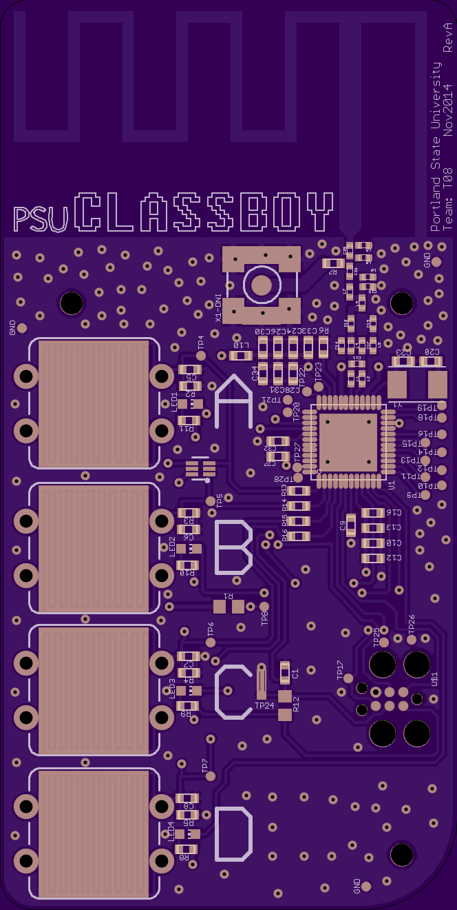
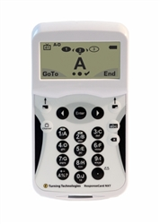
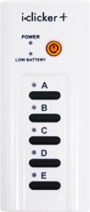
Project Description
Classroom Clicker System
$9.40
$59.50
$45
Notes:
Key Idea: What is a classroom clicker?
Facilitate real-time feedback system for data polling

Slide 4

Motivation
Notes:
Key Idea: Andrew solicited the class to build a system with his specifications
1st week of class

Slide 5
Requirements
Primary
Cost Sensitive <$15
Minimum 100 Simultaneous Devices
Reliable: <0.1% Loss of Votes
Range: Lecture Hall
Notes:
Key Idea: Primary Design Requirements

Slide 6
Feature List
Secondary
Long Operational Lifetime
2-Way Radio
Notes:
Key Idea: Secondary Features for project

Slide 7
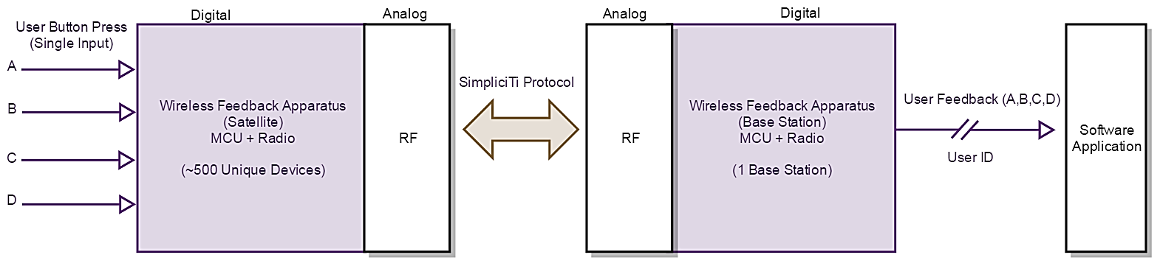
Implementation
Notes:
Key Idea: Functionality
What are the inputs/outputs
How are we transmitting data

Slide 8
Implementation
Satellite
Base Station
Python GUI
Notes:
Key Idea: Modules that were developed for this system

Slide 9
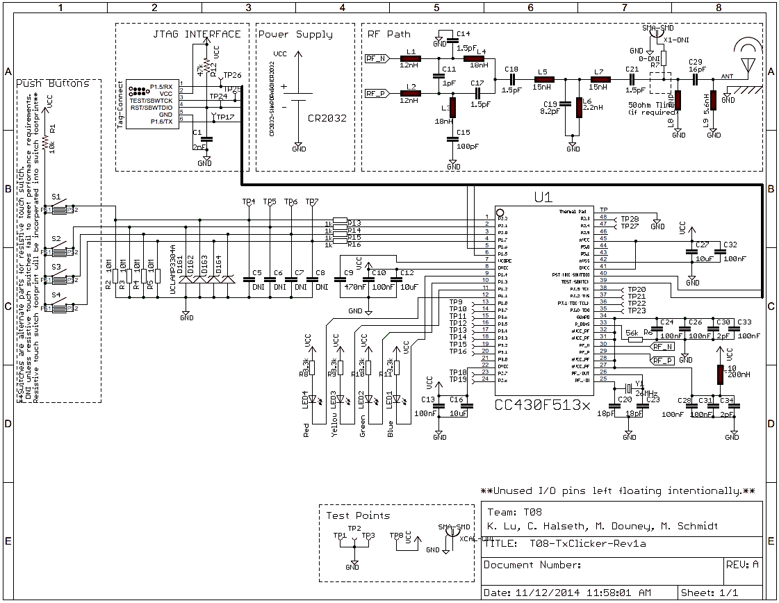
Schematic

Slide 10
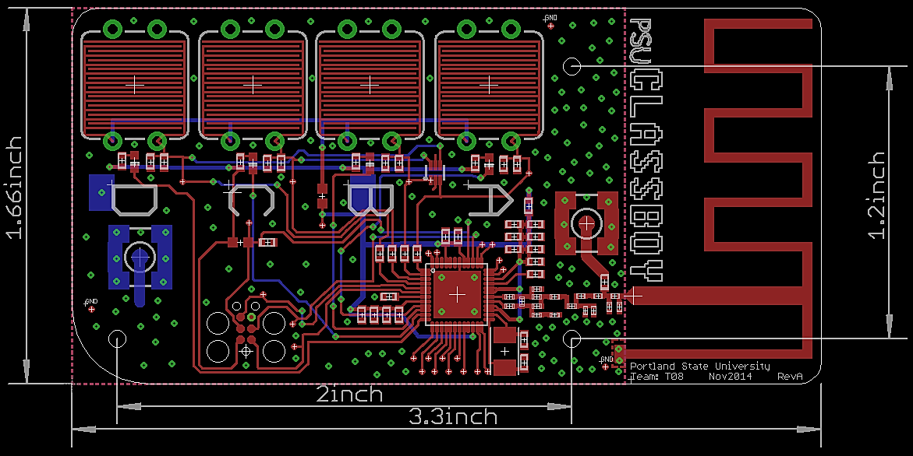
Board Layout

Slide 11
Testing Strategy
Level 1: Unit Testing
Level 2: Integrated Testing
Level 3: System Testing
Level 4: System Level

Slide 12
Lessons Learned

Slide 13
IP and Prior Work
Python Modules
PySerial, Time, CSV, TkInter
MSPExp430F6137Rx User Experience
MSPExp430F5137Rx User Experience
Texas Instruments SimpliciTI Protocol

Slide 14
Contributions
K. Lu System Level Design Schematic/PCB Layout Construct 4x Boards Bill of Materials | C. Halseth RF Antenna Design Resistive Button Design Base Station Program Satellite Program ~1000 Lines of Code PCB Layout
M. Schmidt Python GUI Development ~380 Lines of Code Developed Export Data Algorithm System Test & Verification | M. Downey System Test & Verification System Documentation Code Review

Slide 15
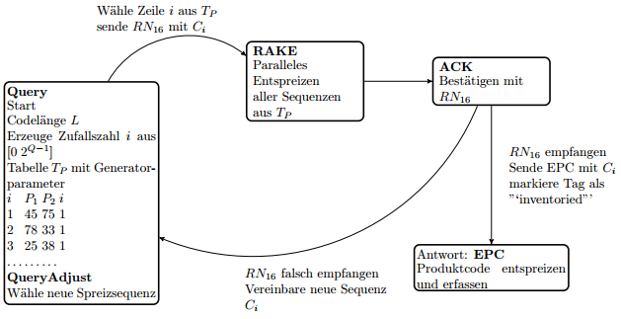

Slide 16
Demonstration
Q1: How would you grade this presentation on a scale of A-D? (A = Asstastic)

